Slide 1


BTech IV Year VII Semester Section:
BCSE0103: SOFT COMPUTING
(Artificial Neural Network)
Dr. Manmohan Singh
Assistant Professor- Dept. of Computer Engineering & Applications
Email- Manmohan.singh@gla.ac.in

Slide 2
BCSE0103: SOFT COMPUTING
Objective: Students will get an insight of the intelligent computational approaches. Providing students, the mathematical background to carry out optimization.
Neural Networks: Introduction to Soft Computing & Neural Computing, Fundamentals of Artificial Neural Network(ANN), Models of ANN, ANN models: Rosenblatt’s Perception, McCulloch & Pitts Model, Single Layer Perceptron, Learning Methods in Perceptron, Linearly Separable Task and XOR Problem, Multi-Layer Perceptron, Back Propagation Learning Algorithm, Associative Memory: Hopfield network, Auto Associative Memory, Bidirectional Hetro-Associative Memory, ADALINE, MADALINE Network, Applications of Neural Network.
Fuzzy Logic: Introduction to Fuzzy Sets & Crisp Sets, Fuzzy Membership and Fuzzy Operations, Properties of Fuzzy Sets- Linguistic Hedges, Fuzzy Logic – T-norms and other aggregation operators, Crisp Relations.

Slide 3
BCSE0103: SOFT COMPUTING
Fuzzy Logic: Fuzzy Relations, Fuzzy System, Crisp Logic, Propositional Logic and its Laws, Inference in Propositional Logic, Fuzzy Logic, Inference in Fuzzy Logic (GMP and GMT), Fuzzy Rule Based System, Fuzzyfication & Defuzzification, Applications of Fuzzy Logic.
Genetic Algorithm(GA):Introduction to GA, Search optimization Method, Evolutionary Algorithm Working Principle, Biological Background of GA, Working Principles of GA, Encoding(Binary, Value, Permutation, Tree), Operators of GA(Random Population, Reproduction or Selection), Crossover and Mutation, Basics of Genetic Algorithm with Examples, Introduction to Genetic programming
Text Books:
S. Rajsekaran& G.A. VijayalakshmiPai, “Neural Networks, Fuzzy Logic and Genetic Algorithm: Synthesis and Applications”, 4th Edition, Prentice Hall of India,2003.

Slide 4
BCSE0103: SOFT COMPUTING
Reference Books:
Timothy J Ross ,"Fuzzy Logic with Engineering Applications", 3rd Edition, John Wiley and Sons,2016.
David E. Goldberg ,"Genetic Algorithm in Search Optimization and Machine Learning "Adission-Wesley,2009.
Karray, “Soft Computing and Intelligent Systems Design: Theory, Tools and Applications”, 1st Edition, Pearson Education,2009.
Outcome: After completion of course, student will be able to:
CO1: Understand basics of Soft Computing including Artificial Neural Networks, Fuzzy Logic and Genetic Algorithms.
CO2: Demonstrate the ability to develop some familiarity with current research problems and research methods in Soft Computing by working on a research or design project.
CO3: Understand about the fundamental theory and concepts of neural networks, neuro modeling, several neural networks paradigms and its applications.
CO4: Design and implement the concepts of knowledge using fuzzy inference systems and other machine intelligence applications.
CO5: Identify an evolutionary computing paradigm known as genetic algorithms and its applications to engineering optimization problems.

Slide 5

Agenda
Introduction to Soft Computing
Concept of computing
Important characteristics of ”Computing”
Soft computing vs. ”Hard” Computing
Few examples of Soft computing applications
Characteristics of Soft computing
Hybrid computing

Slide 6
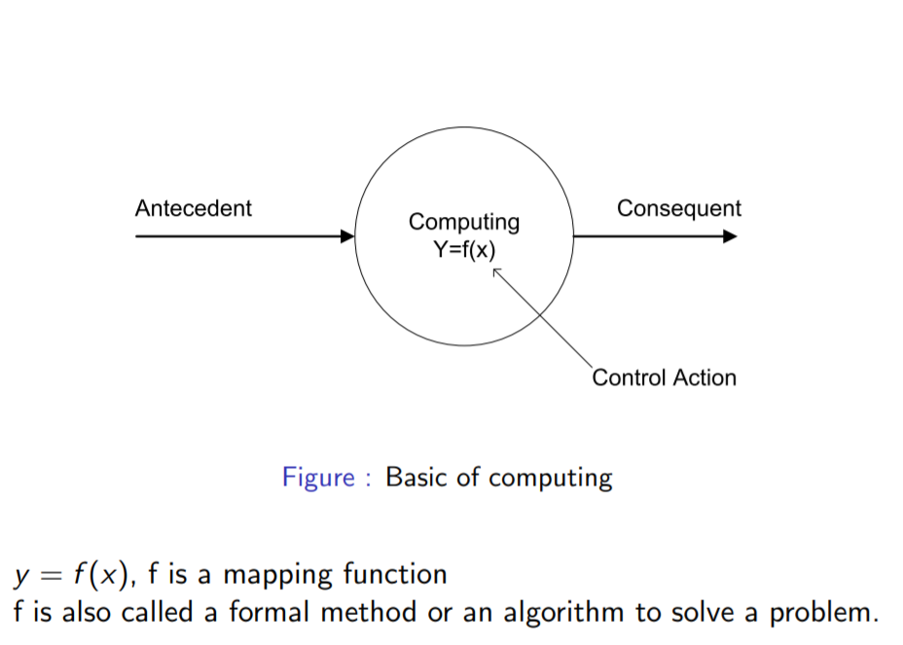
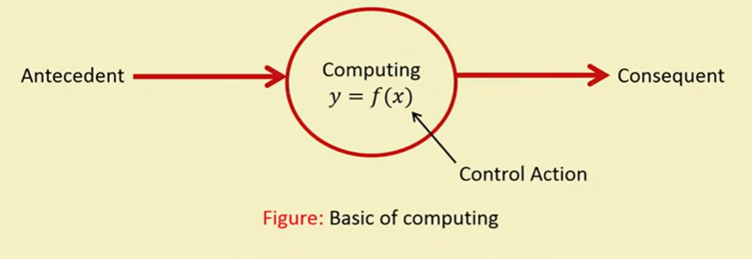
Concept of Computing

Slide 7
Important Characteristics of Computing
Should provide precise solution.
Control action should be unambiguous and accurate.
Suitable for problem, which is easy to model mathematically

Slide 8
Hard Computing
In 1996, LA Zade (LAZ) introduced the term hard computing.
According to LAZ: We term a computing as ”Hard” computing, if
Precise result is guaranteed
Control action is unambiguous
Control action is formally defined (i.e. with mathematical model or algorithm)
Example of Hard Computing:
Solving numerical problems (e.g. Roots of polynomials, Integration etc.)
Searching and sorting techniques
Solving ”Computational Geometry” problems (e.g. Shortest tour in Graph theory, Finding closest pair of points etc.)

Slide 9
Problem Areas of Hard Computing
Problems in some other areas of applications
Medical diagnosis
Person identification
Computer vision
Hand written character recognition
Pattern recognition and Machine Intelligence MI
Weather forecasting

Slide 10
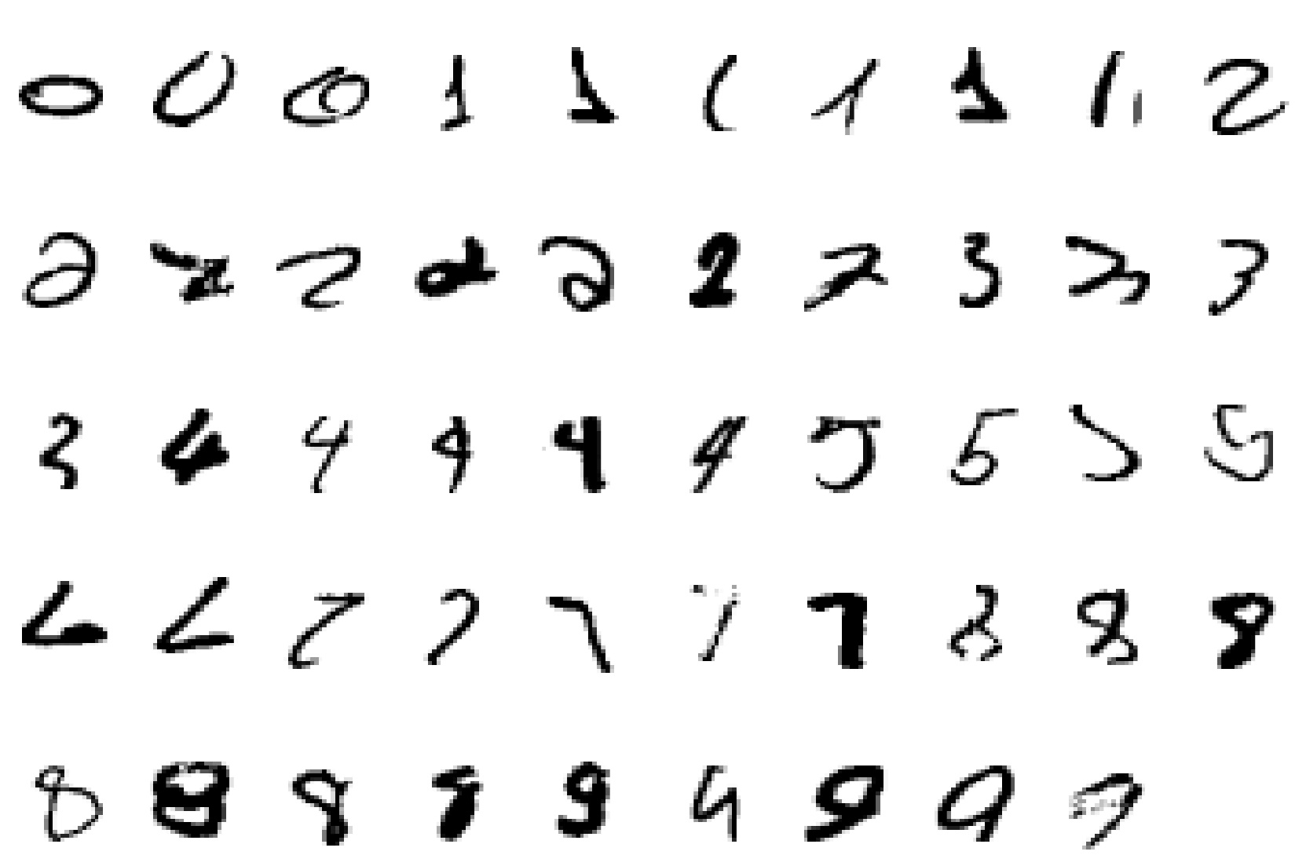
A classic example of a task that requires machine learning: It is very hard to say what makes a 2

Slide 11
Some more examples of tasks that are best solved by using a learning algorithm
Recognizing patterns:
Facial identities or facial expressions
Handwritten or spoken words
Medical images
Recognizing anomalies:
Unusual sequences of credit card transactions
Unusual patterns of sensor readings in a nuclear power plant or unusual sound in your car engine.
Prediction:
Future stock prices or currency exchange rates

Slide 12
Some more examples….
Some web-based examples of machine learning are….
The web contains a lot of data. Tasks with very big datasets often use machine learning
especially if the data is noisy or non-stationary.
Spam filtering, fraud detection:
The enemy adapts so we must adapt too.
Recommendation systems:
Lots of noisy data. Million dollar prize!
Information retrieval:
Find documents or images with similar content.

Slide 13
Soft Computing
The term soft computing was proposed by the inventor of fuzzy logic, Lofti A. Zadeh. He describes it as follows.
Definition:-Soft computing is a collection of methodologies that aim to exploit the tolerance for imprecision and uncertainty to achieve tractability, robustness, and low solution cost, Its principal constituents are fuzzy logic ,neuro-computing, and probabilistic reasoning.
The role model for soft computing is the human mind.

Slide 14
Characteristics of Soft Computing
It does not require any mathematical modeling of problem solving.
It may not yield the precise solution
Algorithms are adaptive (i.e. it can adjust to the change of dynamic environment)
Use some biological inspired methodologies such as genetics, evolution, Ant’s behaviors, particles swarming, human nervous systems etc.

Slide 15
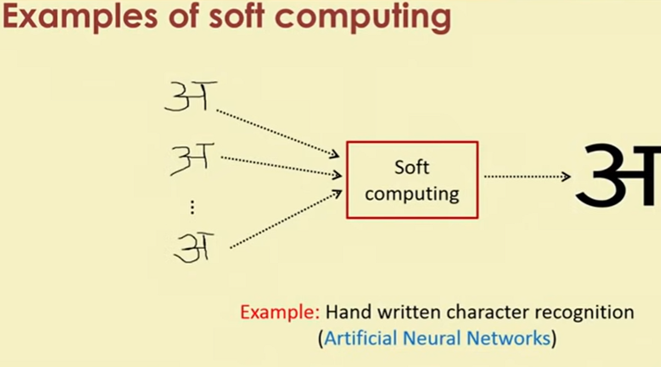


Slide 16
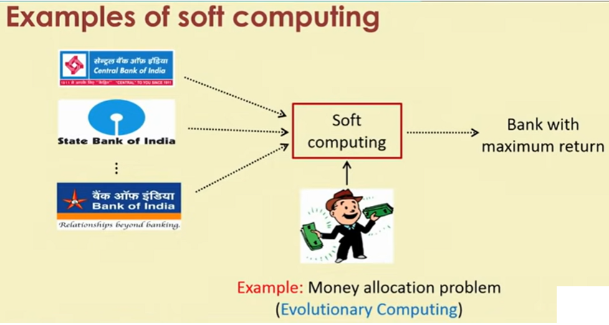

Slide 17
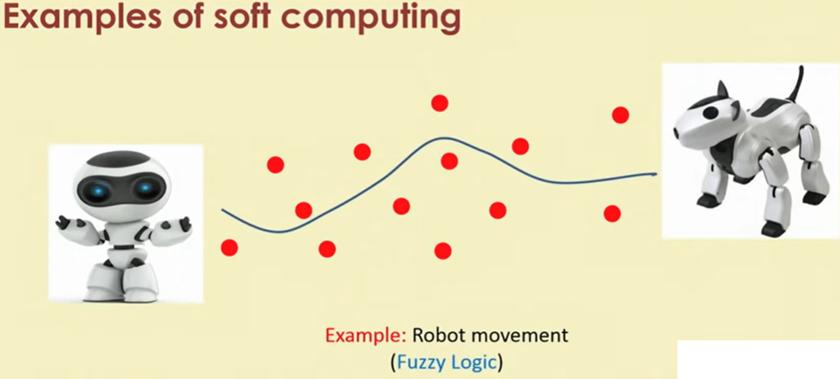

Slide 18
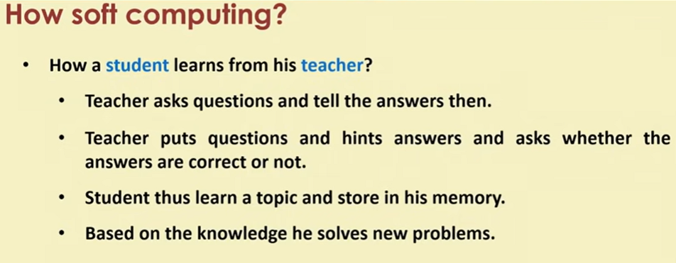
How Soft Computing?
How a student learns from his teacher?
Teacher asks questions and tell the answers then.
Teacher puts questions and hints answers and asks whether the answers are correct or not.
Student thus learn a topic and store in his memory.
Based on the knowledge he solves new problems.
This is the way how human brain works.
Based on this concepts Artificial Neural Networks is used to solve problem

Slide 19
How Soft Computing?
How world selects the best?
It starts with a population(random).
Reproduces another population(Next Generation).
Rank the population and selects the superior individuals.
Genetic Algorithm is based on this natural phenomena.
Population is synonymous to solutions.
Selection of superior is synonymous to exploring the optimal solution.

Slide 20
How Soft Computing?
How a doctor treats his patient?
Doctor asks the patient about suffering.
Doctor find the symptoms of diseases.
Doctor prescribed tests and medicines.
This is exactly the way Fuzzy logic works.
Symptoms are correlated with diseases with uncertainty
Doctor prescribes tests/medicines fuzzily.

Slide 21
Hard Computing vs Soft Computing
Hard Computing | Soft Computing
It requires a precisely stated analytical model and often a lot of Computation time | It is tolerant of imprecision, uncertainty, partial truth and approximation
It is based on binary logic crisp system, numerical analysis and crisp software. | It is based on fuzzy logic, neural nets and probabilities reasoning.
It has the characteristics of precision and categoricity. | It has the characteristics of approximation and dispositionality

Slide 22
Hard Computing vs Soft Computing
Hard Computing | Soft Computing
It is deterministic | It incorporates stochasticity
It requires exact input data | It can deal with ambiguous and noisy data
It is strictly sequential. | It allows parallel computations
It produces precise answers | It can yield approximate answers

Slide 23
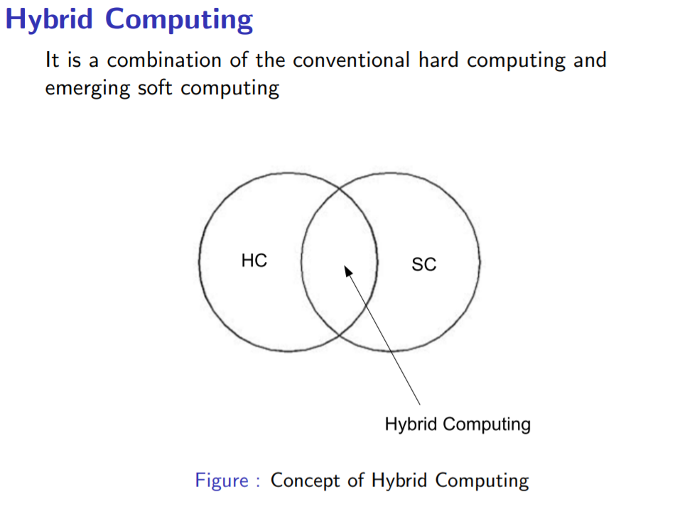
Hybrid Computing

Slide 24
In this course…. How to build an artificial neural networks and train it with input data to solve a number of problems, which are not possible to solve with hard computing. Basic concepts of fuzzy algebra and then how to solve problems using fuzzy logic. The framework of genetic algorithm and solving varieties of optimization problems.

Slide 25
MCQ
Q.1.Which of these has been associated with fuzzy logic?
a. Many-valued logic b. Crisp set logic
c. Binary set logic d. Two-valued logic
Answer: (a) Many-valued logic

Slide 26
MCQ
Q.2.Hard Computing is/are…
Deterministic (b) incorporates stochasticity
(c) Bothe a & b (d) None of these
Ans:- (a) Deterministic

Slide 27
MCQ
Q.3.Soft computing is /are…
incorporates stochasticity
(b) Deterministic (c)both a & b
(d)None of these
Ans:- (a) incorporates stochasticity

Slide 28
MCQ
Q.4. The term soft computing was proposed by the inventor of fuzzy logic, Lofti A. Zadeh
Charles Babbage
(b) Lofti A. Zadeh (c) Alan Turing
(d)None of these
Ans:- (b) Lofti A. Zadeh

Slide 29
Questions
Q1. Differentiate Hard Computing and Soft Computing?
Q2. What are the problems which can be solved by soft computing?

Slide 30
Biological nervous system
Biological nervous system is the most important part of many living things, in particular, human beings.
There is a part called brain at the center of human nervous system.
In fact, any biological nervous system consists of a large number of interconnected processing units called neurons.
Each neuron is approximately 10µm long and they can operate in parallel.
Typically, a human brain consists of approximately 10¹¹ neurons communicating with each other with the help of electrical impulses.

Slide 31

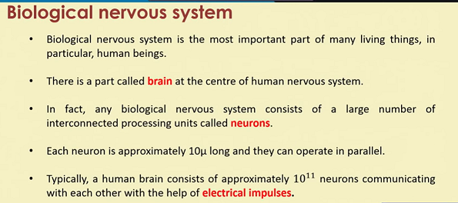
Biological nervous system

Slide 32
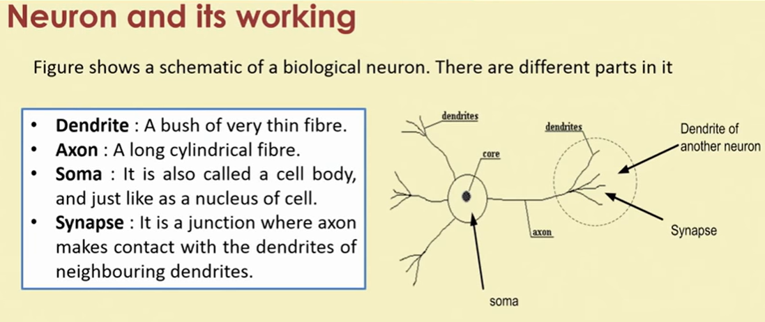
Biological nervous system

Slide 33
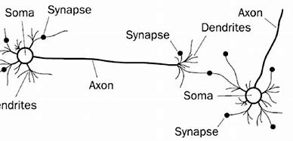
Neuron and its working

Slide 34
Neuron and its working
There is a chemical in each neuron called neurotransmitter.
A signal (also called sense) is transmitted across neurons by this chemical.
That is, all inputs from other neuron arrive to a neurons through dendrites.
These signals are accumulated at the synapse of the neuron and then serve as the output to be transmitted through the neuron. An action may produce an electrical impulse, which usually lasts for about a millisecond.
Note that this pulse generated due to an incoming signal and all signal may not produce pulses in axon unless it crosses a threshold value.
Also, note that an action signal in axon of a neuron is commutative signals arrive at dendrites which summed up at soma.

Slide 35
Brain: Center of the nervous system
Brain | Computer
1. Analogue | 1.Digital
2. uses content addressable memory | 2.Uses byte addressable memory
3. Massive parallel mechanism | 3. Serial and modular approach
4. Processing speed is not fixed; no system clock | 4. Processing speed is fixed
5.Synapses are far more complex than logic gates | 5. Easier than the architecture of Brain
6. Much bigger than any computer | 6. Not so big.

Slide 36
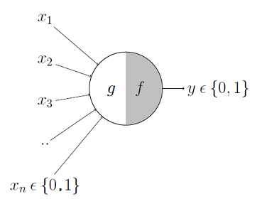
MuCulloch Pit Neuron
The first computational model of a neuron was proposed by Warren MuCulloch (neuroscientist) and Walter Pitts (logician) in 1943.
It may be divided into 2 parts. The first part, g takes an input (ahem dendrite ahem), performs an aggregation and based on the aggregated value the second part, f makes a decision.

Slide 37
Artificial neural network
In fact, the human brain is a highly complex structure viewed as a massive, highly interconnected network of simple processing elements called neurons.
Artificial neural networks (ANNs) or simply we refer it as neural network (NNs), which are simplified models (i.e. imitations) of the biological nervous system, and obviously, therefore, have been motivated by the kind of computing performed by the human brain.
The behavior of a biolgical neural network can be captured by a simple model called artificial neural network.

Slide 38
Task of a Neuron
We may note that a neutron is a part of an interconnected network of nervous system and serves the following.
Compute input signals
Transportation of signals (at a very high speed)
Storage of information
Perception, automatic training and learning
We also can see the analogy between the biological neuron and artificial neuron. Truly, every component of the model (i.e. artificial neuron) bears a direct analogy to that of a biological neuron. It is this model which forms the basis of neural network (i.e. artificial neural network).

Slide 39
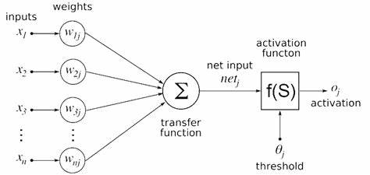
Artificial neural network

Slide 40
Artificial neural network
Here, x₁, x_{2,} · · · , x_{n} are the n inputs to the artificial neuron. w₁, w₂, · · · , w_{n} are weights attached to the input links.
Note that, a biological neuron receives all inputs through the dendrites, sums them and produces an output if the sum is greater than a threshold value.
The input signals are passed on to the cell body through the synapse, which may accelerate or retard an arriving signal.
It is this acceleration or retardation of the input signals that is modeled by the weights.
An effective synapse, which transmits a stronger signal will have a correspondingly larger weights while a weak synapse will have smaller weights.
Thus, weights here are multiplicative factors of the inputs to account for the strength of the synapse.

Slide 41
Artificial Neural Network
Hence, the total input say I received by the soma of the artificial neuron is I = w₁x₁ + w₂x₂ + · · · + w_{n}x_{n} = ∑^{n}_{i=1} w_{i}x_{i}
To generate the final output y, the sum is passed to a filter φ called transfer function, which releases the output. That is, y = φ(I).

Slide 42
Mathematical Understanding
A very commonly known transfer function is the thresholding function.
In this thresholding function, sum (i.e. I) is compared with a threshold value θ.
If the value of I is greater than θ, then the output is 1 else it is 0 (this is just like a simple linear filter).
In other words, y = φ( ∑ ^{n}_{i=1} w_{i}x_{i} − θ)
where φ(I) = 1 , if I > θ
0 , if I ≤ θ Such a Φ is called step function (also known as Heaviside function).

Slide 43
MCQ
1. Why do we need biological neural networks?
a) to solve tasks like machine vision & natural language processing
b) to apply heuristic search methods to find solutions of problem
c) to make smart human interactive & user friendly system
d) all of the mentioned
Answer: d -Explanation: These are the basic aims that a neural network achieve.
2. What is the trend in software nowadays?
a) to bring computer more & more closer to user
b) to solve complex problems
c) to be task specific
d) to be versatile
Answer: a- Explanation: Software should be more interactive to the user, so that it can understand its problem in a better fashion.

Slide 44
MCQ
3. What’s the main point of difference between human & machine intelligence?
a) human perceive everything as a pattern while machine perceive it merely as data
b) human have emotions
c) human have more IQ & intellect
d) human have sense organs
Answer: a -Explanation: Humans have emotions & thus form different patterns on that basis, while a machine(say computer) is dumb & everything is just a data for him.

Slide 45
MCQ
4. What is auto-association task in neural networks?
a) find relation between 2 consecutive inputs
b) related to storage & recall task
c) predicting the future inputs
d) none of the mentioned
Answer: b - Explanation: This is the basic definition of auto-association in neural networks.
5. Does pattern classification belongs to category of non-supervised learning?
a) yes
b) no
Answer: b - Explanation: Pattern classification belongs to category of supervised learning.

Slide 46
MCQ
6. In pattern mapping problem in neural nets, is there any kind of generalization involved between input & output?
a) yes
b) no
Answer: a - Explanation: The desired output is mapped closest to the ideal output & hence there is generalisation involved.
7. What is unsupervised learning?
a) features of group explicitly stated
b) number of groups may be known
c) neither feature & nor number of groups is known
d) none of the mentioned
Answer: c - Explanation: Basic definition of unsupervised learning.

Slide 47
MCQ
8. Does pattern classification & grouping involve same kind of learning?
a) yes
b) no
Answer: b - Explanation: Pattern classification involves supervised learning while grouping is an unsupervised one.
9. Does for feature mapping there’s need of supervised learning?
a) yes
b) no
Answer: b - Explanation: Feature mapping can be unsupervised, so it’s not a sufficient condition.

Slide 48
MCQ
10. The fundamental unit of network is
a) brain
b) nucleus
c) neuron
d) axon
Answer: c - Explanation: Neuron is the most basic & fundamental unit of a network .
11. What are dendrites?
a) fibers of nerves
b) nuclear projections
c) other name for nucleus
d) none of the mentioned
Answer: a - Explanation: Dendrites tree shaped fibers of nerves.

Slide 49
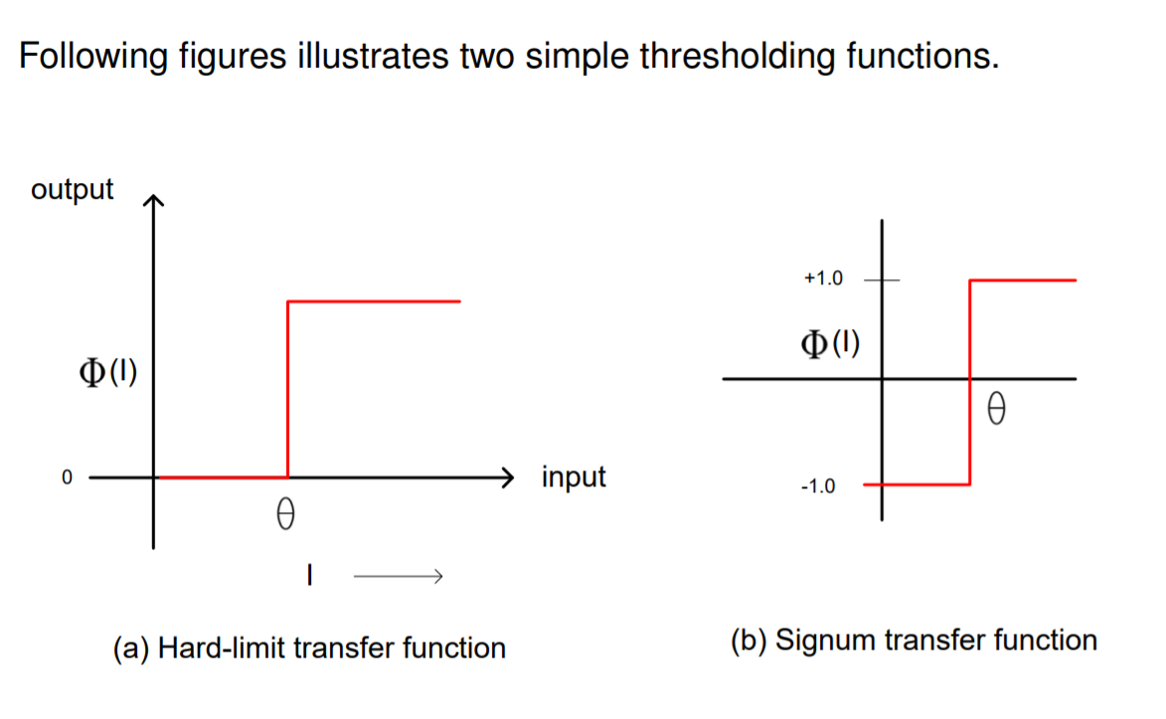
Types of Transfer Function

Slide 50
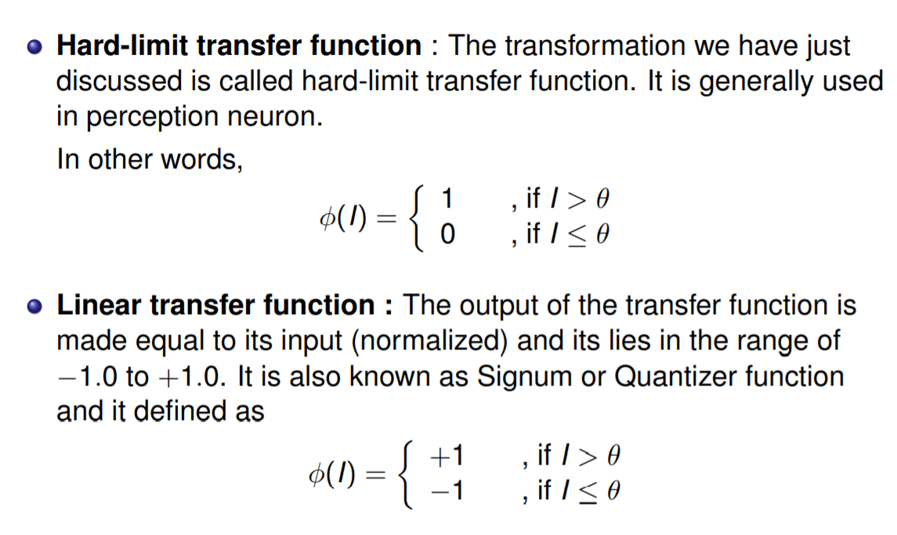
Types of Transfer Function

Slide 51
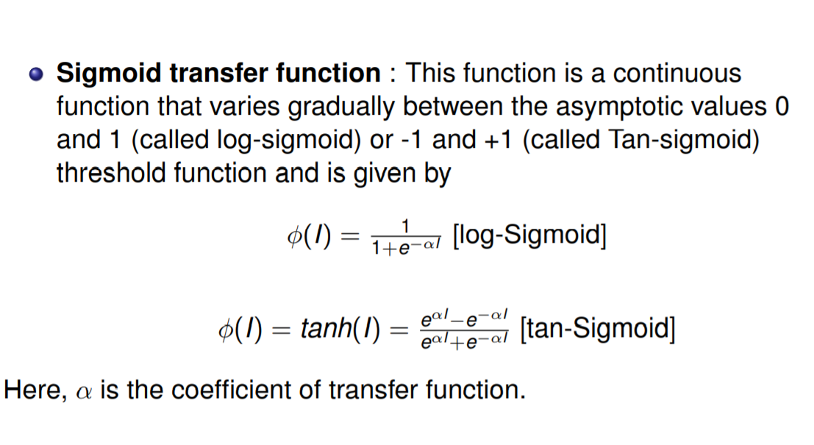
Other Transfer functions

Slide 52
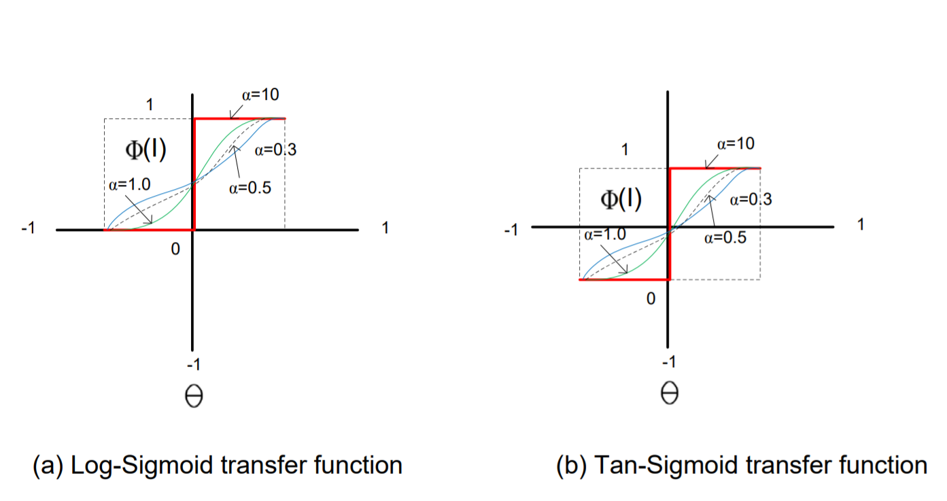
Other Transform Functions

Slide 53
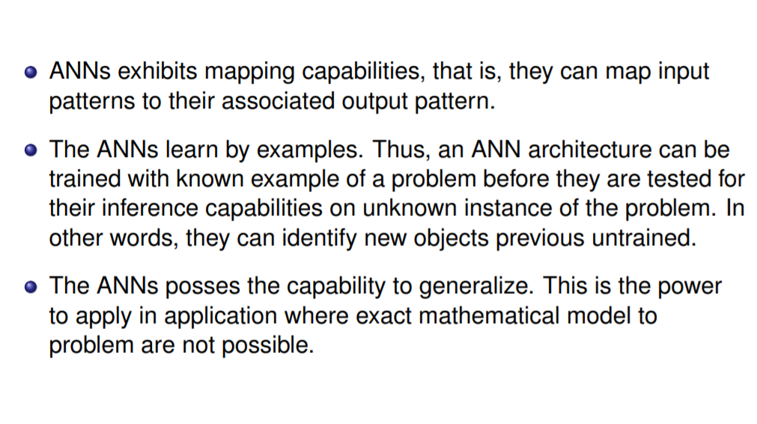
Advantages of ANN

Slide 54
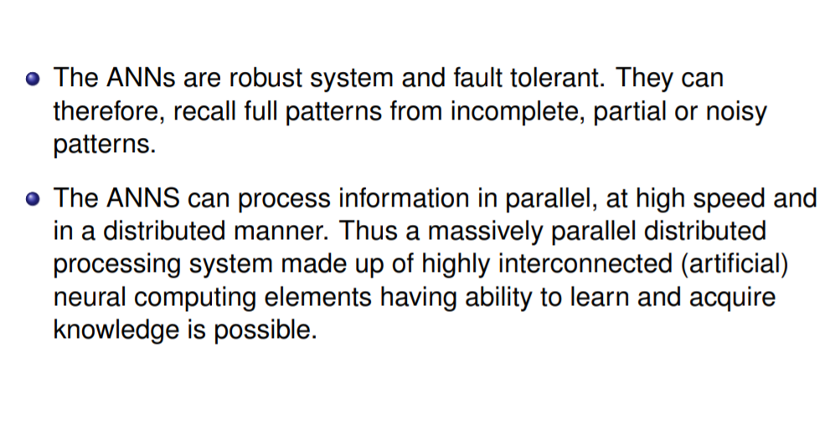
Advantages of ANN

Slide 55
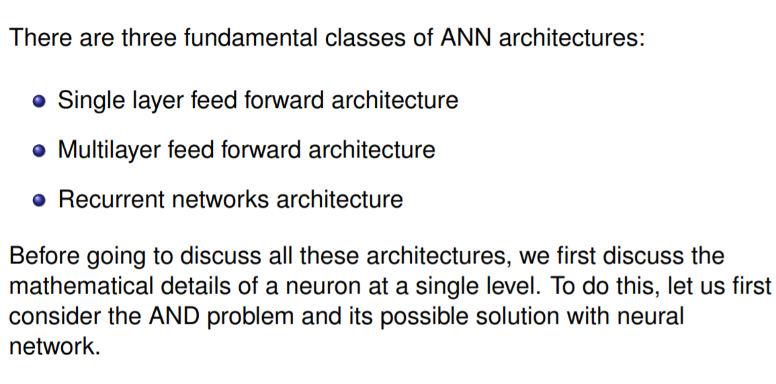
Types of ANN Architecture

Slide 56
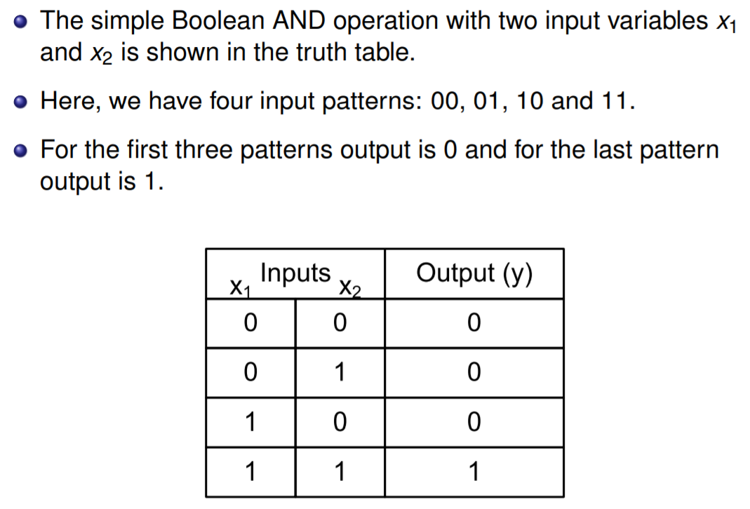
AND Problem and its Neural Network

Slide 57
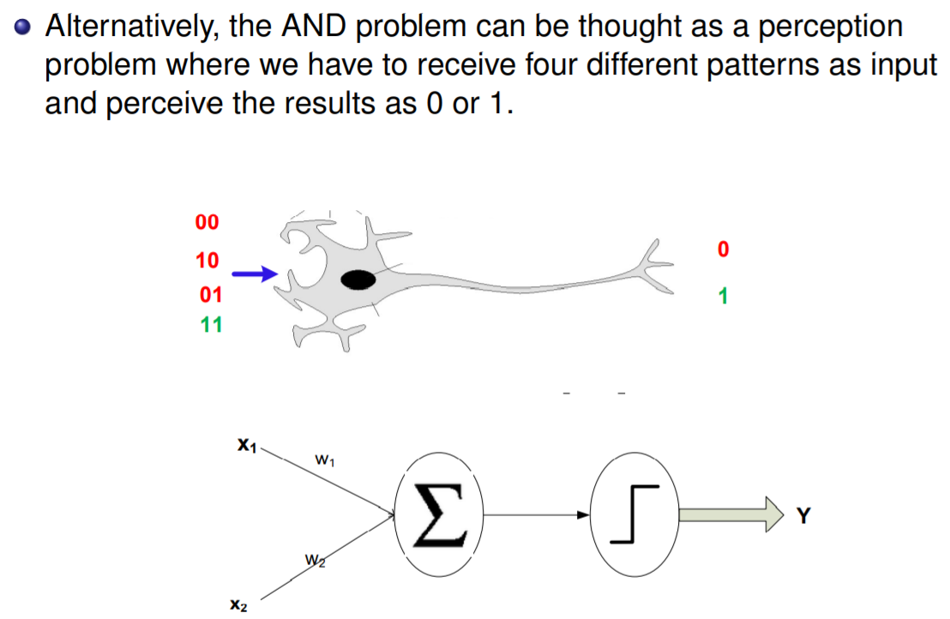
AND Problem and its Neural Network

Slide 58
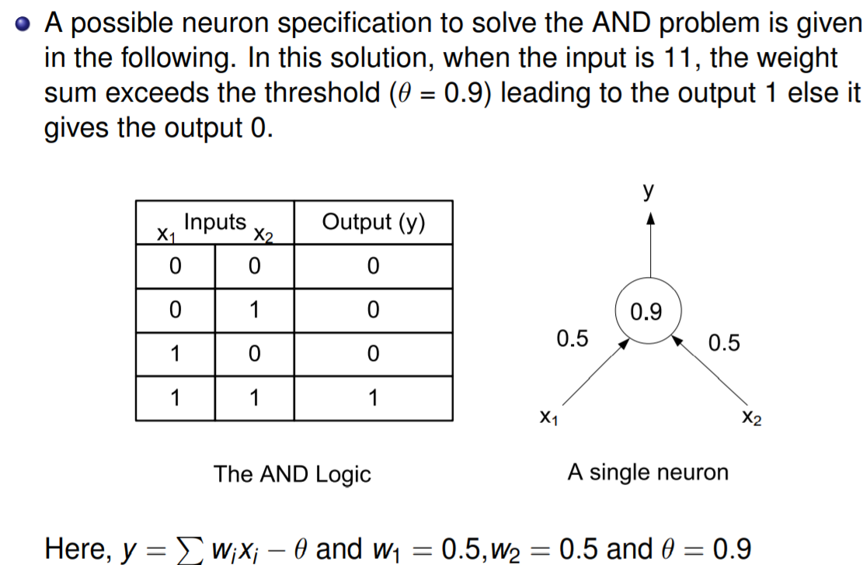
AND Problem and its Neural Network

Slide 59

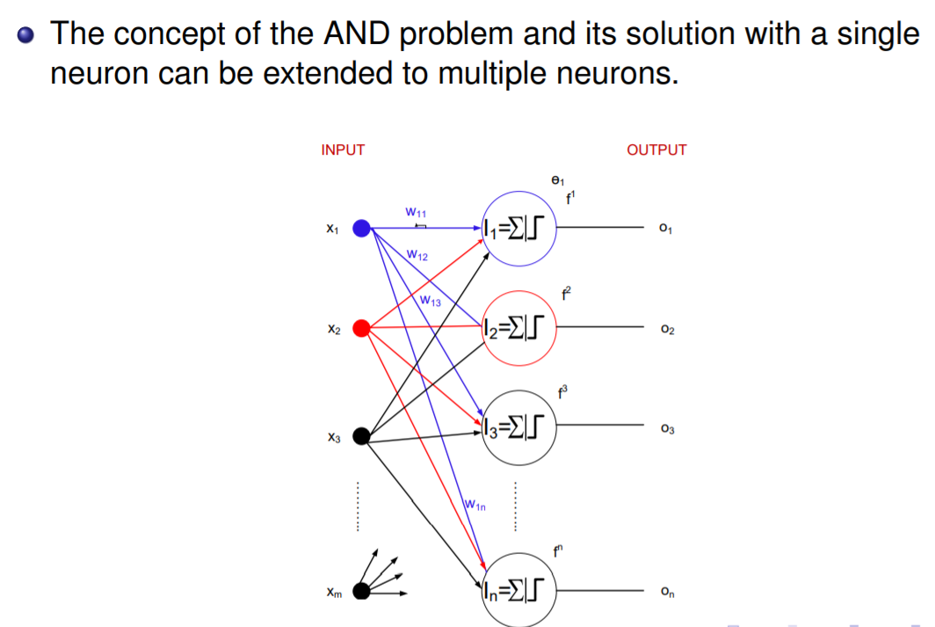
Single layer feed forward Neural Network

Slide 60
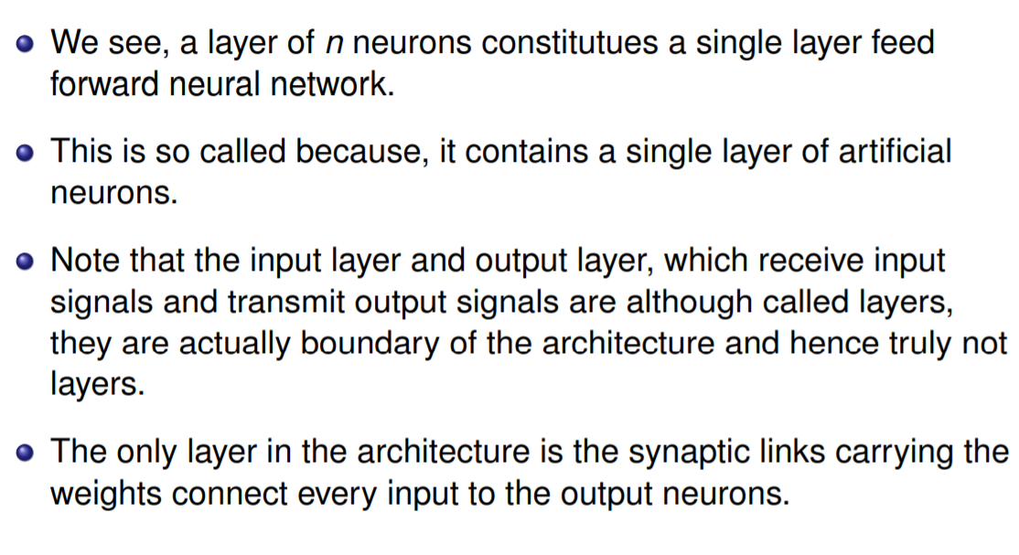
Single layer feed forward Neural Network

Slide 61
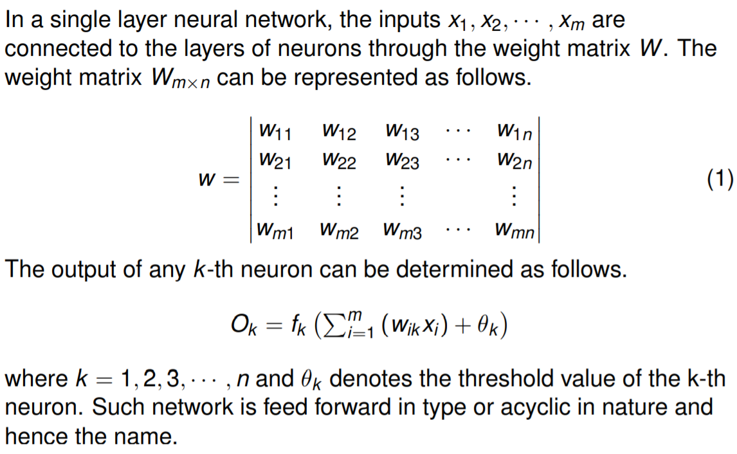
Modelling SLFFNN

Slide 62
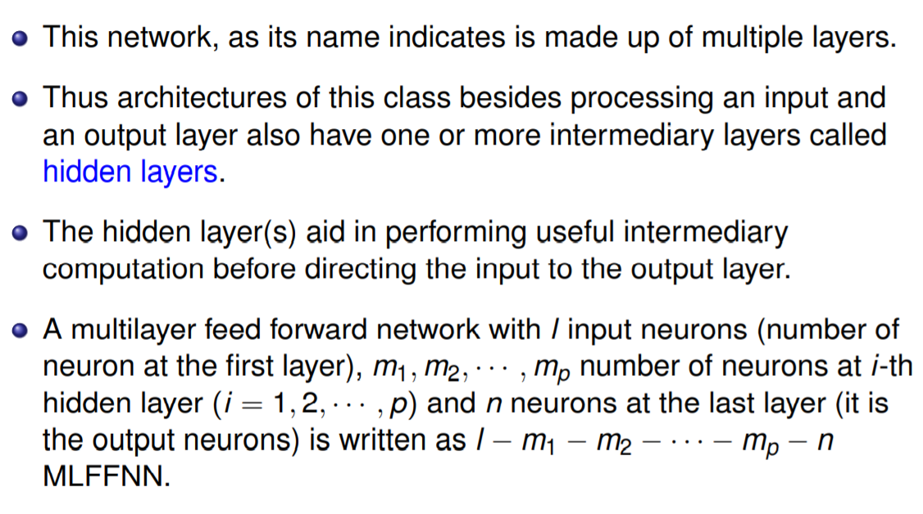
Multi layer feed forward Neural Network
Accuracy or Classification rate: Overall, how often is the classifier correct?
Ans. (TP+TN)/total = (100+50)/165 = 0.91

Slide 63
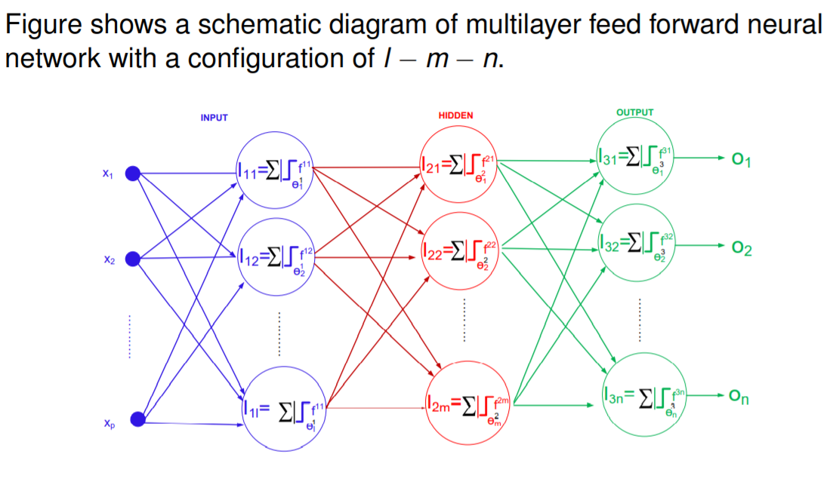
Multi layer feed forward Neural Network

Slide 64
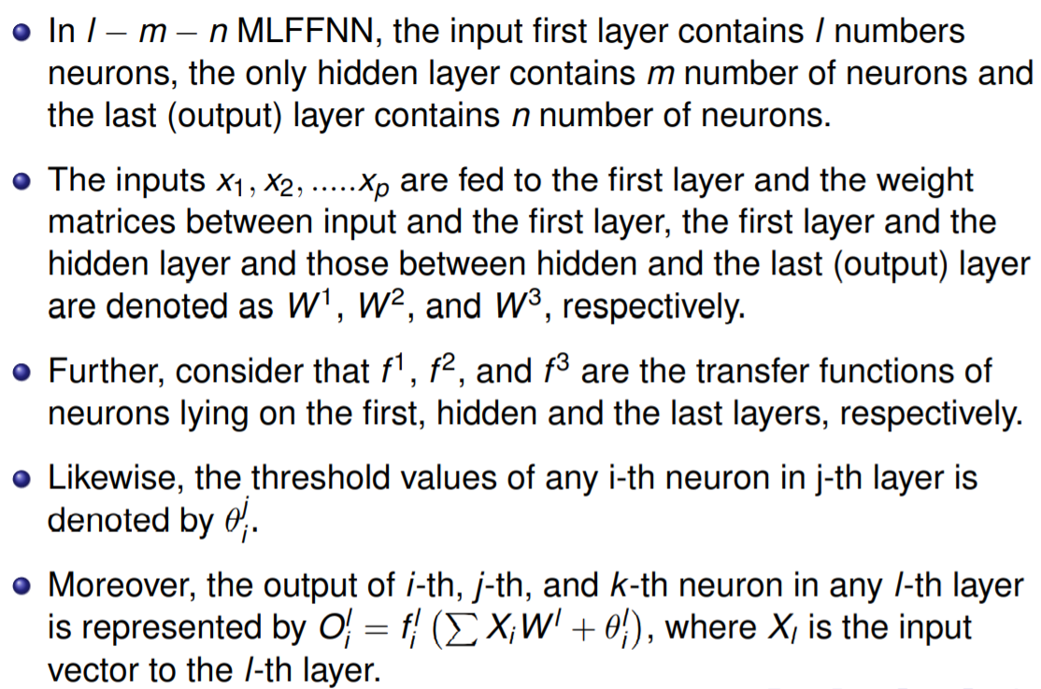
Multi layer feed forward Neural Network

Slide 65
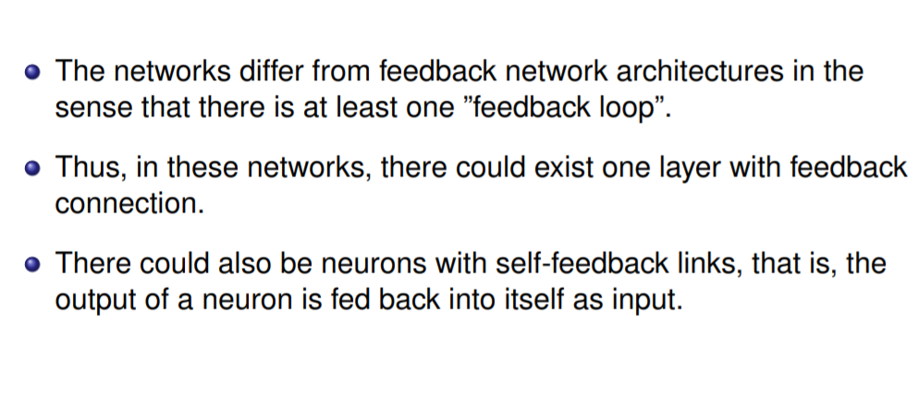
Recurrent Neural network Architecture

Slide 66
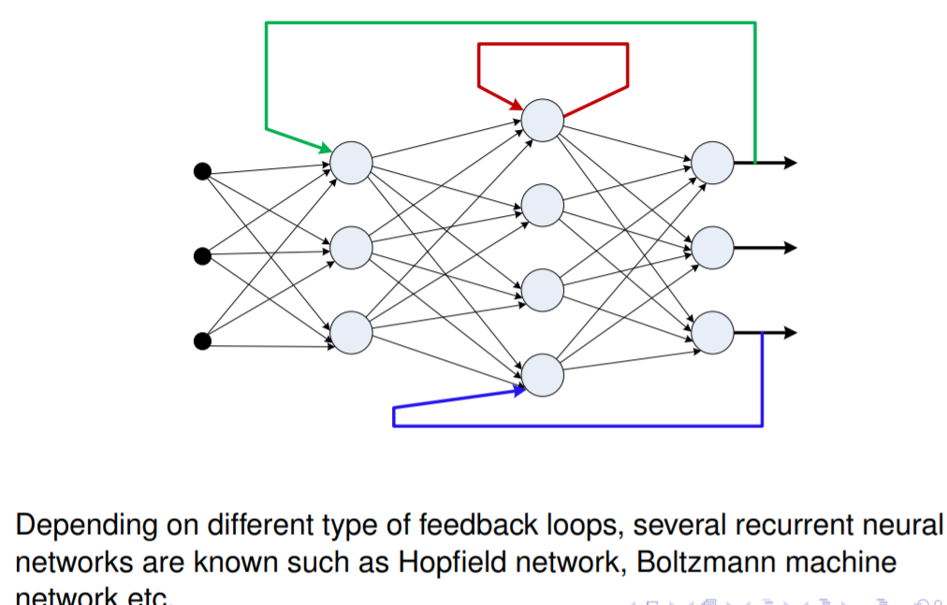
Recurrent neural Network

Slide 67
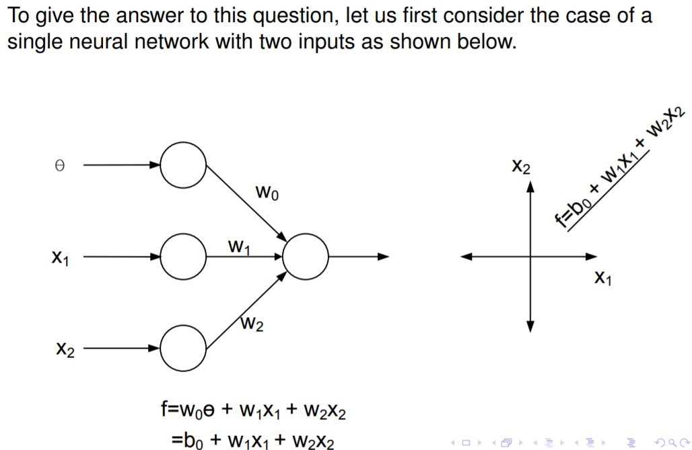
Why Different types of neural network

Slide 68
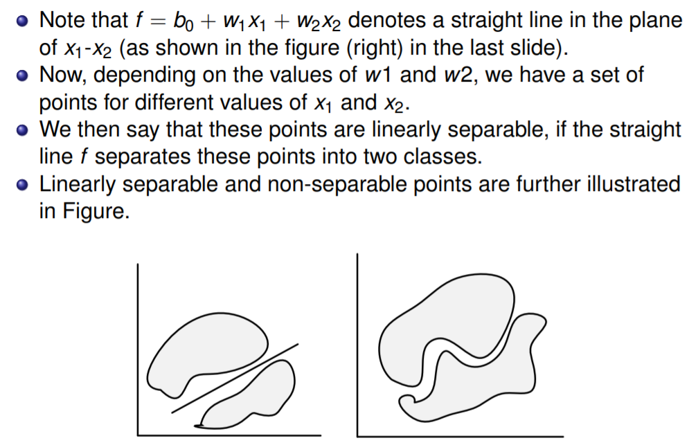
Revisit of a single neural network

Slide 69
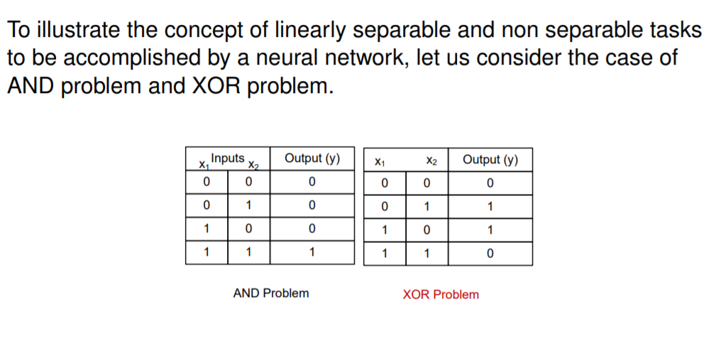
AND and XOR problems

Slide 70
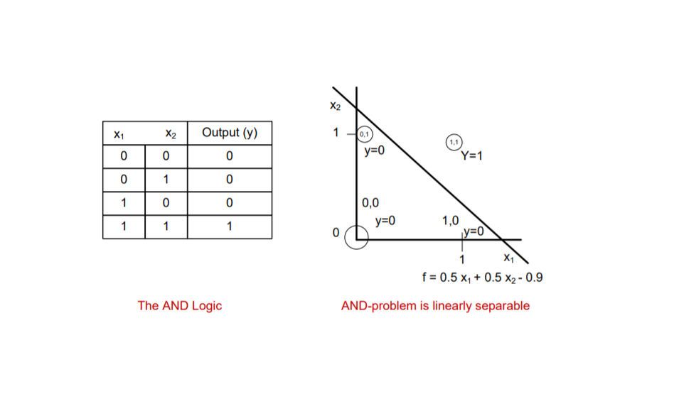
AND problem is linearly separable

Slide 71
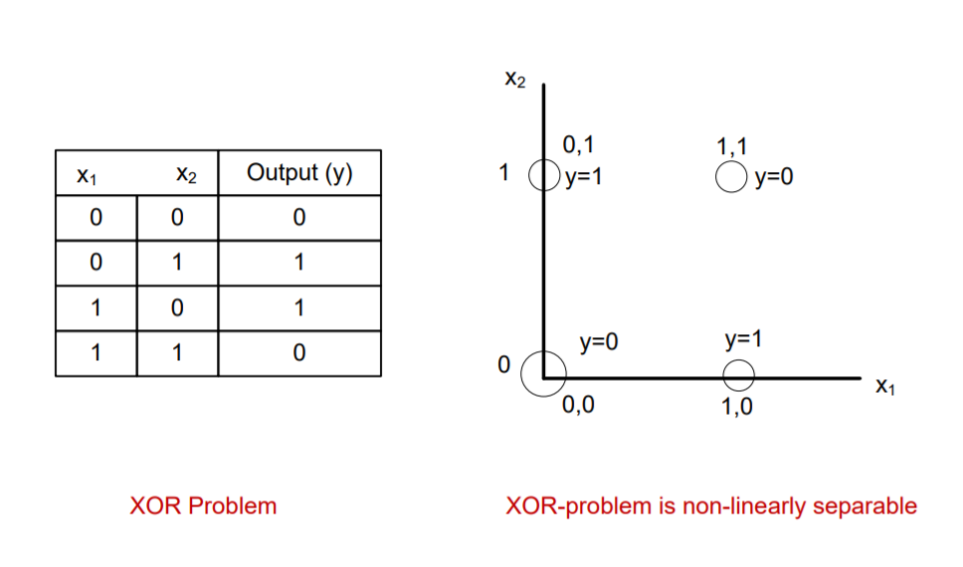
XOR problem is linearly non-separable

Slide 72
Our observations
From the example discussed,
we understand that a straight line is possible in AND-problem to separate two tasks namely the output as 0 or 1 for any input.
However, in case of XOR problem, such a line is not possible. Note: horizontal or a vertical line in case of XOR problem is not admissible because in that case it completely ignores one input.

Slide 73
Our observations
In fact, any linearly separable problem can be solved with a single layer feed forward neural network. For example, the AND problem.
On the other hand, if the problem is non-linearly separable, then a single layer neural network can not solves such a problem. To solve such a problem, multilayer feed forward neural network is required.

Slide 74
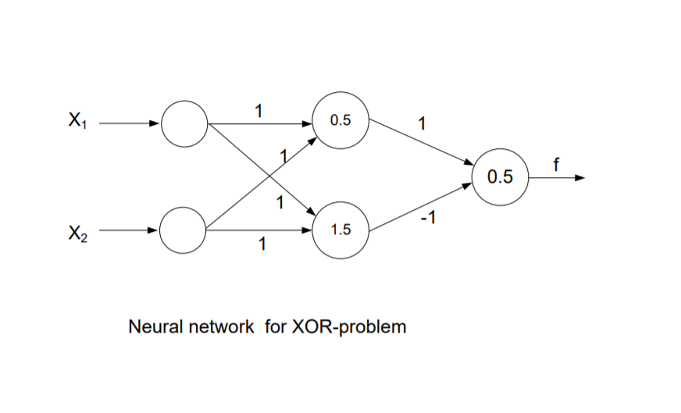
Solution of XOR Problem

Slide 75
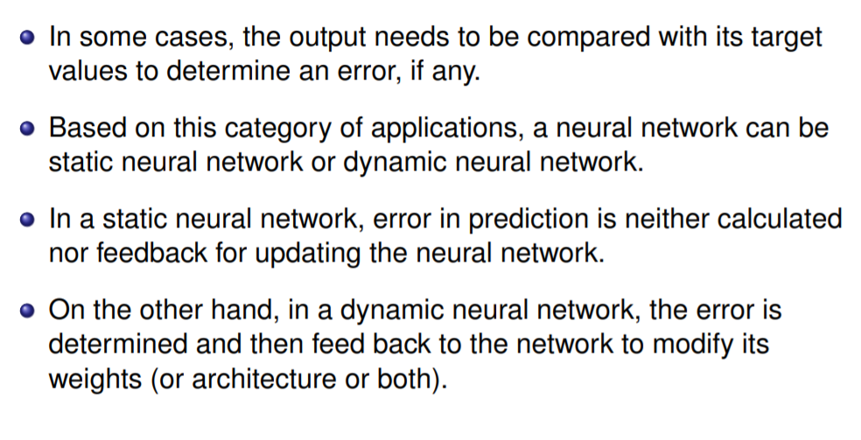
Dynamic neural Network

Slide 76
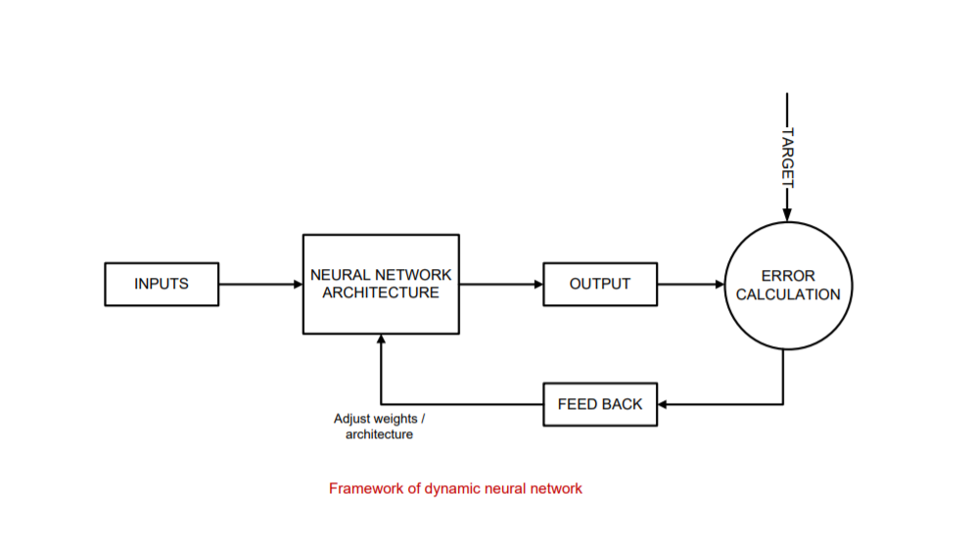
Dynamic neural Network

Slide 77
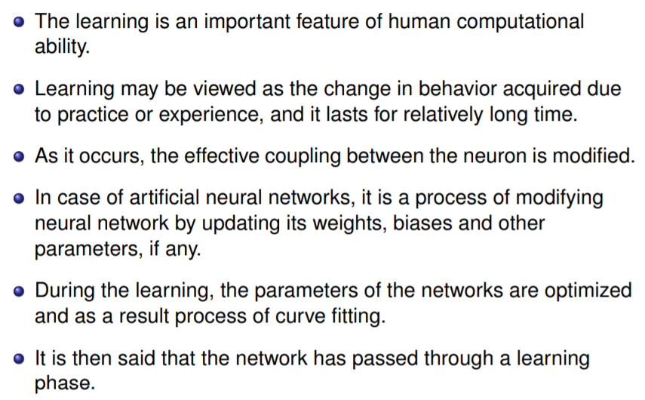
Concept of Learning in neural Network

Slide 78
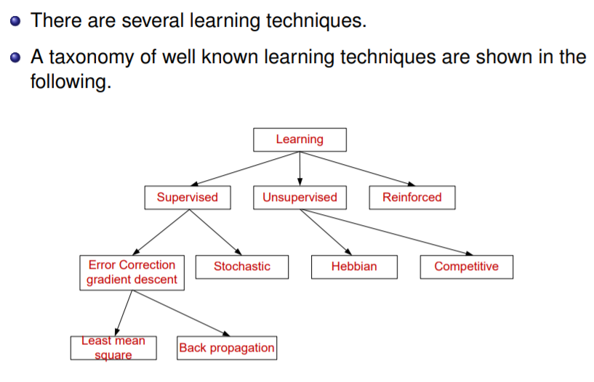
Types of Learning

Slide 79
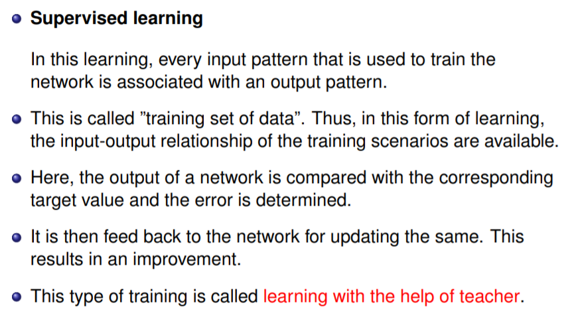
Supervised Learning

Slide 80
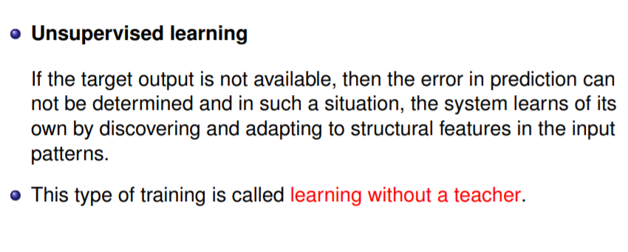
Unsupervised Learning

Slide 81
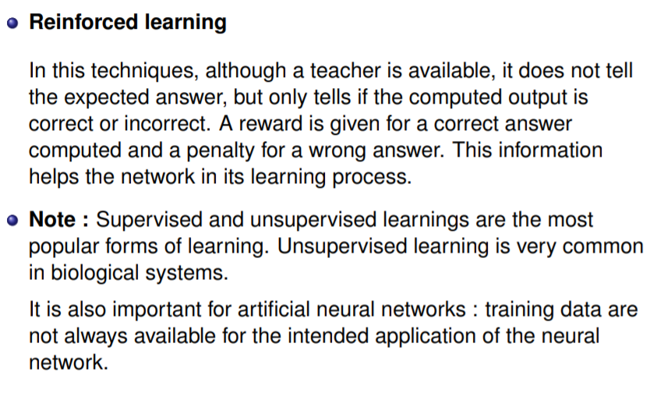
Reinforcement Learning

Slide 82
Adaline and Madaline network
Adaline and madaline comes under the supervised learning networks
ADALINE:
Known as Adaptive Linear Neuron
Adaline is a network with a single linear unit
The Adaline network is trained using the delta rule.
Adaline is a single-unit neuron, which receives input from several units and also from one unit, called bias. An Adeline model consists of trainable weights. The inputs are of two values (+1 or -1) and the weights have signs.

Slide 83
Adaline and Madaline network
2. Medaline
stands for multiple adaptive linear neuron
It consists of many adalines in parallel with a single output unit whose value is based on certain selection rules.
It uses the majority vote rule
On using this rule, the output unit would have an answer either true or false.
On the other hand, if AND rule is used, the output is true if and only if both the inputs are true and so on.

Slide 84
Back Propagation Learning
Back-propagation is the essence of neural net training.
It is the practice of fine-tuning the weights of a neural net based on the error rate (i.e. loss) obtained in the previous epoch (i.e. iteration). Proper tuning of the weights ensures lower error rates, making the model reliable by increasing its generalization.

Slide 85
How Back Propagation Algorithm Works
The backpropagation algorithm works by computing the gradient of the loss function with respect to each weight by the chain rule, computing the gradient one layer at a time, iterating backward from the last layer to avoid redundant calculations of intermediate terms in the chain rule.

